Slide 1
A Quick Introduction to JMP
Dara Hammond
JMP Account Rep

Slide 2
What is JMP?
A statistical visualization and discovery tool that graphically displays and analyzes data and results
A desktop software package to help you discover relationships in your data
32-bit handles about 2 million rows, 64-bit is nearly limitless
Point and click
Fun and Interactive ways to visualize your data
Dynamically links results and data
Available on Windows and Mac
Integrate with SAS, Excel, and R to explore results in an interactive way
Other areas – Design of Experiments, Visual Six Sigma
Other products – JMP Pro, JMP Genomics, JMP Clinical

Slide 3
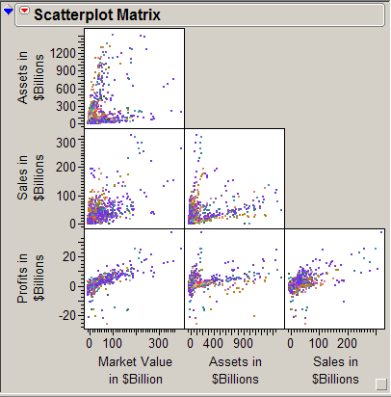
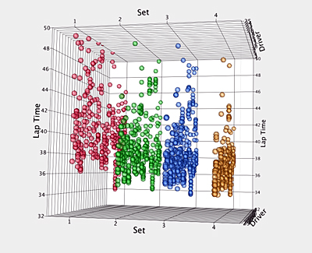
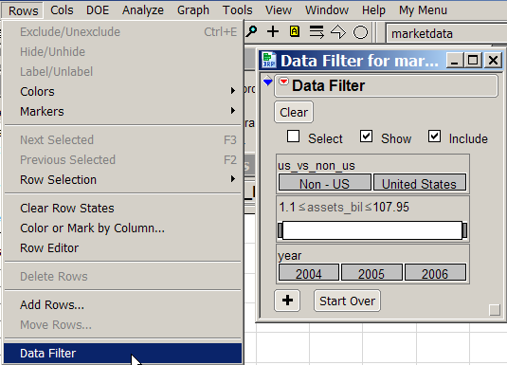

Cool Interactive Visualization

Slide 4

Bubble Plot

Slide 5
Prediction Profiler

Slide 6
Tell me more about this SAS Integration……
JMP can “browse” and access data defined in the SAS metadata server or libraries on a SAS server (except OLAP cubes)
Ability to run SAS stored processes (authored in SAS)
SAS stored process can include JMP Scripting Language (JSL) to create interactive graphics
JMP reads and writes SAS data sets and transport files
SAS generates JMP data tables using PROC EXPORT with DBMS=JMP
Write SAS code within JMP and submit to local SAS or run a SAS server

Slide 7
What’s this I hear about JMP Pro?
Visual discovery & modeling
Single-user starting point
In-memory computations
Support for tens of millions of data points on 64-bit machines
Bootstrap forest and boosted tree techniques
Generate SAS DATA Step scoring code
Uses train, validate and test methodology
Fully integrated SAS client
Extensible with JSL, SAS, R, Excel, Add-ins

Slide 8
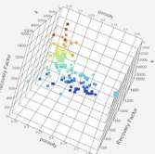
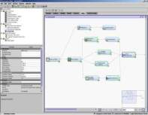
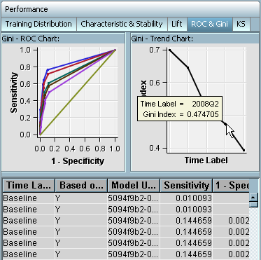
SAS Predictive Analytics Suite
Tailored Environments for Data Mining
Discovery
Development
Deployment
Management & Monitoring
Operationalize
  Automated
  In-database
  Batch or Real-time
  Embedded in Applications
JMP Pro
JMP Pro
SAS Enterprise Miner for Desktop
SAS Enterprise Miner
SAS Analytics Accelerator
SAS Model Manager
SAS Scoring Accelerator
Base SAS, C, Java and PMML Scoring
SAS Model Manager
Notes:
While some technology is necessary for the daily operations of the organization (the central nervous system if you will), the technical infrastructure to help maximize value creation requires an environment for discovery, experimentation, and learning to inform decisions.
It starts with Discovery—even if you know the problem you are trying to solve, you need to spend time exploring the data to determine the best approach—if the data are of sufficient quality on which to base confident decisions.
Once you’ve determined the approach and have a sense of the structure and shape of the data, you can formulate the model, test and validate it. While some of the visuals here reflect predictive models, we don’t want to limit your thinking—these could be optimization models, time series forecasts, social networks, or other models.
The learning can be deployed in multiple ways to inform a number of decisions—as an interactive visualization to show decision makers what they need to know; as a production model deployed in real-time to put the information in context to trigger better operational decisions.
When you think about the number of decisions organizations make every day, the cumulative effect of improving a lot of individual decisions can be of significant value. The technical infrastructure should help more and better decisions take place across the organization.

Slide 9
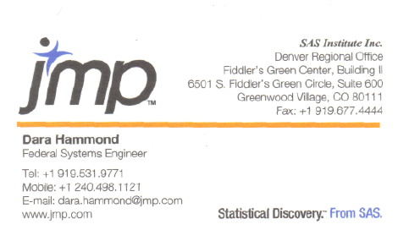
Where to find me…
Account Representative
Central Territory
VoIP Phone..
I really am in Denver!
Tracy’s here too….
  Tracy Shelton
  Tracy.shelton@jmp.com
  919-531-0634

Slide 10
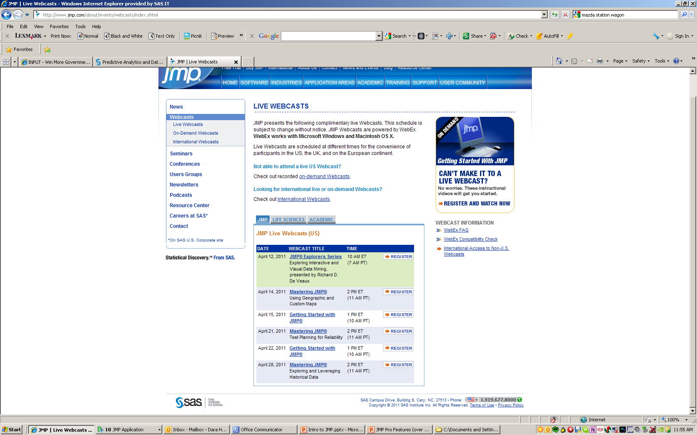
Where to find more...
JMP Website
  www.jmp.com
SAS Predictive Analytics
  http://www.sas.com/technologies/analytics/datamining/index.html
Frequent and FREE Webcasts

Slide 11
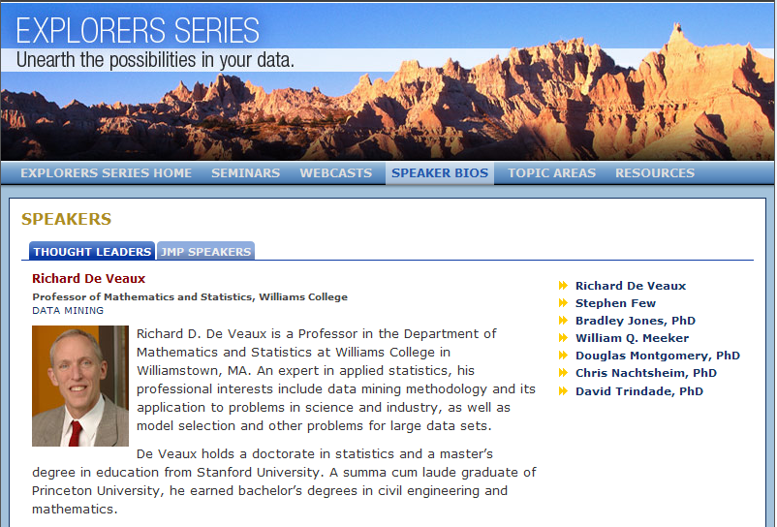
Explorers Series – Boulder, CO
Explorers Series on Predictive Analytics
  Tuesday, June 21, 2011
  http://www.jmp.com/about/events/explorers/

Slide 12
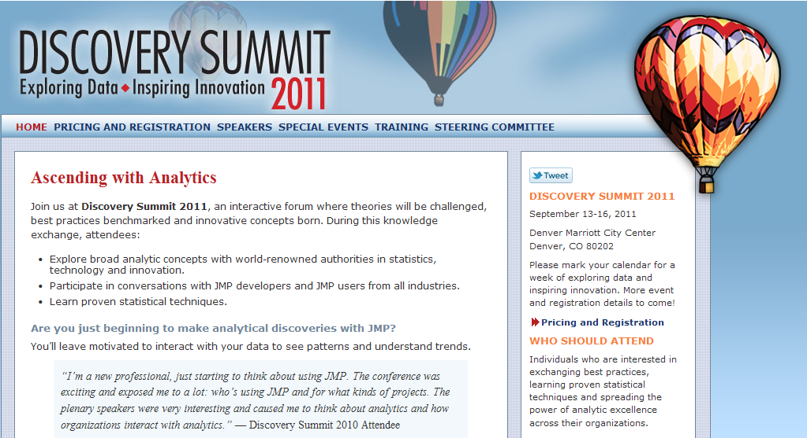
Discovery Summit 2011 – Denver, CO
SAS User Group Members 50% discount!!
  September 13-16, 2011
  http://www.jmp.com/about/events/summit2011/pricing.shtml

